Slide 1
RBE3002 Final Project
By: Team 3: Clayton “Rhododendron” Dembski, Floris “Grashof” van Rossum and Harry Xie

Slide 2
Objectives
Navigate the turtlebot3 robot
Produce a map of the environment
Localize using the map
Produce a path using A*
Navigate to a waypoint in the map

Slide 3
Driving
navToPose()
rotate()
driveStraight()
spinWheels()
Continuous angle adjustment as destination is approached

Slide 4
Driving
Challenges
Timing issues
rospy.get_time()
Transform issues
Extrapolation Exception
Improvements
Driving with curves
Prevent over and under rotation
Find a way to prevent or compensate for drift

Slide 5
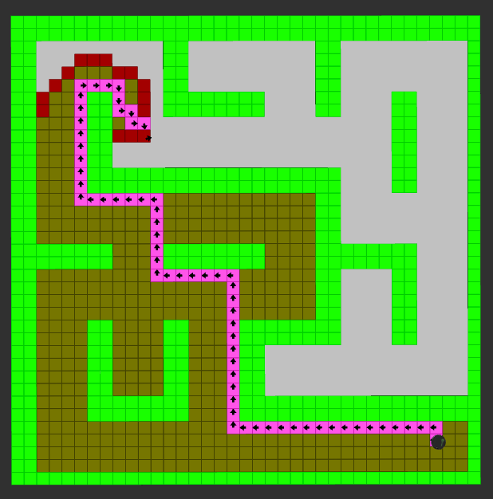
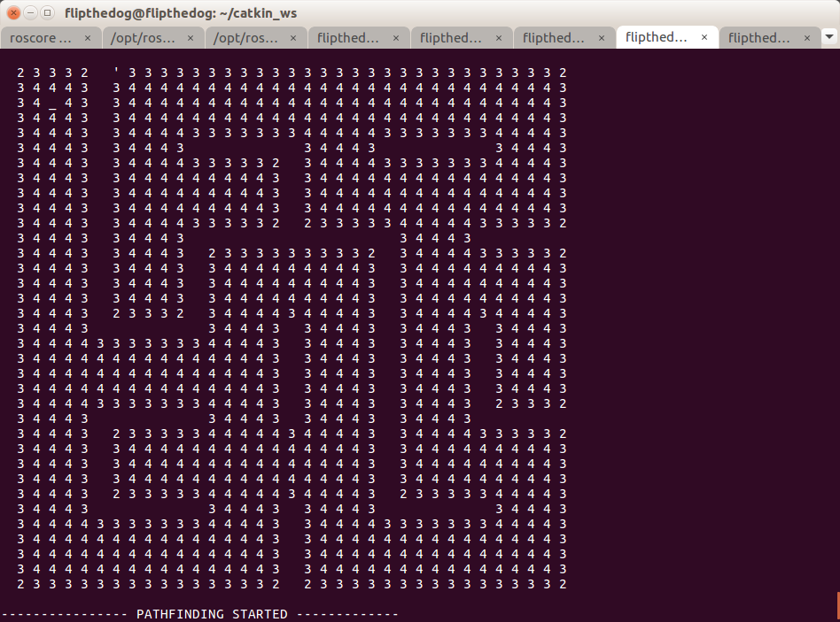
Grids
Made Up of Waypoints:
Point
Occupancy value
List of Connected nodes
Currently 4 connected, could be made 8 connected by updating the list of connected nodes.
Each waypoint only connects to unoccupied nodes
Occupancy updates break the two way connection from a waypoint to all connected waypoints

Slide 6
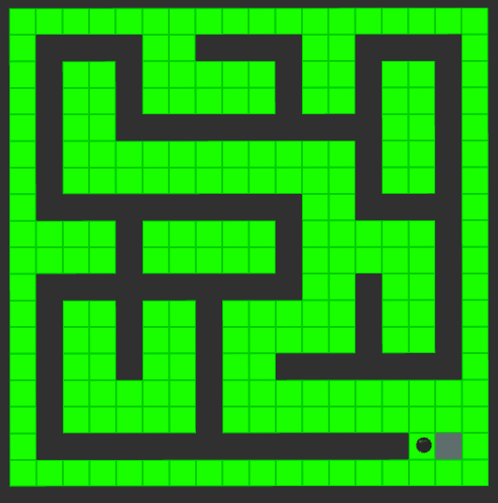
Grids
Cell Expansion:
From the robot size, the grid spaces are expanded to x by x occupancy grid spaces such that the size is larger than the robot. If the robot were 1.5 cells large
Goes to
100 | 0 | 0 | 0
0 | 0 | 0 | 0
0 | 0 | 0 | 0
0 | 0 | 100 | 0
100 | 0
0 | 100

Slide 7
Grids
Future Improvements:
Set up a Ros Message class to transmit Waypoint objects between Nodes. In this way the robot can better detect how close it may be to a grid and compensate.
Expand only using the initial grid cell size so that there is a smaller likelihood of closing off gaps

Slide 8
Frontier
Cells that are adjacent to unknown cells but not adjecent to occupied cells
Frontier cells are grouped in clusters based on distance
Center of the cluster is found
Different frontier cell clusters are ranked
Distance from robot to cluster center
Length of the frontier array
Robot keeps navigating until no more frontiers exist

Slide 9
Frontier

Slide 10
Path - A*
Determine the best possible path based on cell cost and heuristic
Cell Cost: Manhattan distance to previous cell + cell cost of previous neighboring cell + number of neighboring occupied cells
Cells closer to walls are avoided
Heuristic: Euclidian Distance to the goal
Performed as expected
Improvements could be made to avoid walls more by weighting cells close to occupied cells more

Slide 11
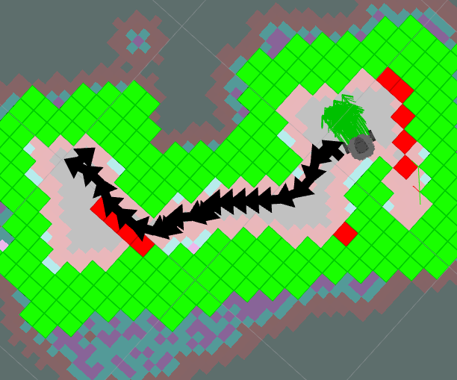
Path
Paths next to a 4 connected wall are pushed out to the edge or corner opposite the robot
Has the unintended side effect of smoothing the curve, as 8 connected points are not moved.
Future Improvements:
Better smoothing when away from walls
Reducing drift and slippage
Removing path waypoints when unnecessary

